Slide 1
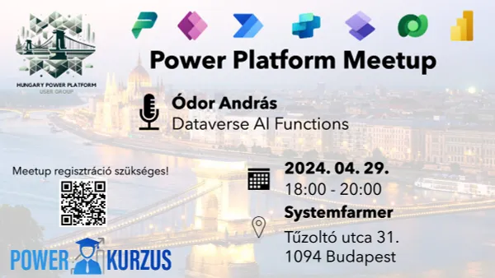


Slide 2



Hungary Power Platform User Group April Meetup
2024.04.29.
Start: 18:10
Wifi code:
Host: Mate Toth
Helyszín & Szponzor:
Szponzor:

Slide 3

Experts Live Europe – Budapesten!
20% off:
HPPUG-20-2024
Valid until Sep 1!

Slide 4
Experts Live Europe – Giveaway soon!
1 full conference ticket up for grabs!

Slide 5

Our session today:
Dataverse AI Functions
Presenter: Andras Odor

Slide 6
Dataverse AI Actions

Slide 7

Ódor András
Systemfarmer Zrt.
MS certified consultant, developer, architect.
Doing Dynamics / Power Platform for 8 years
Mostly D365 Sales and Marketing Applications
No-code + Low-code + Pro-code
Favorite Pokemon: Psyduck
andras.odor@systemfarmer.hu
csonthejjas@gmail.com
https://www.linkedin.com/in/odor-andras
I dont do social media...

Slide 8
Agenda
Dataverse actions
Available AI Actions
Ways to use them
How do they work
Costs
Pro & Con
Q&A and demo all the way

Slide 9
Dataverse Actions
Processes exposed on the Web API of Dynamics
Usually implement more complex operations then CRUD
Bound and Unbound
Bound
Only operates within the context of an entity type and record
E.g.: AddToQueue (queue record)
Unbound
As name suggests, not bound any to entity types
Operates only with the provided parameters
E.g.: Merge
AI Actions

Slide 10
Available AI Actions
AIClassify
AIExtract
AITranslate
AIReply
AISentiment
AISummarize
AISummarizeRecord
Ready to use actions without any training or configuration.
Notes:
There is one for every common scenario
Classify: Provide categories and free form text, gives back unknown or one of the categories
Extract: Provide a noun and free form text. Gives back the extracted list of entities. E.g.: Names, Locations
Translate: Provide a target language and free form text. Gives back the translated text
Reply: Provide free form text (email as context), gives back a suggested reply text.
Sentiment: Provide free form text, gives back one of Povitive, Neutral, Negative
Summarize: Provide free-form text, gives back a best effort summarized version of it.
SummaarizeRecord: Provide a Dataverse record id as context and gives back a summarization of said record

Slide 11
Other AI Actions
Other available unbound AI actions
AnalyzeSentiment
DetectLanguage
ExtractKeyPhrases
ExtractTextEntities
RecognizeText
All the above expects a trained model as parameter

Slide 12
Ways to use them
Via
Dataverse connector in PA
PowerFX in Canvas Apps

Slide 13
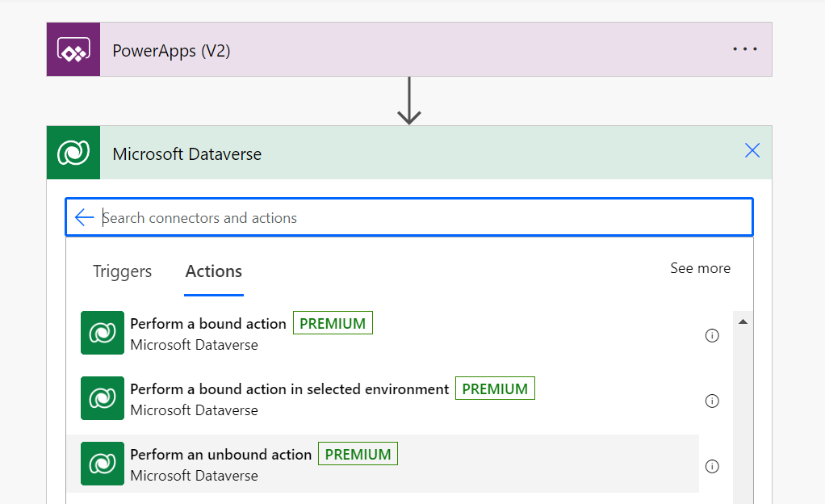
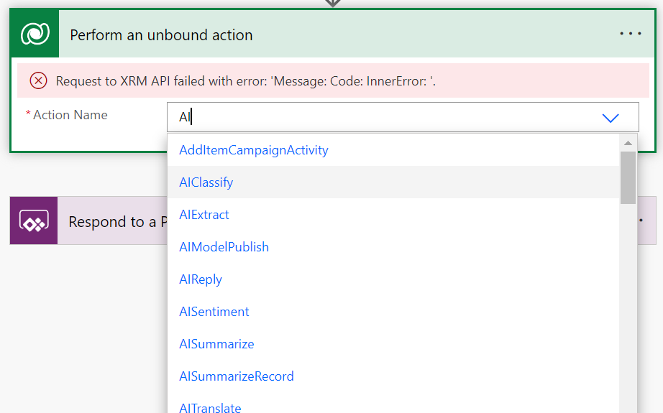
Power Automate Dataverse connector
Select Dataverse connector and Perform unbound action
Filter for AI
Easy to use, most of them have 1 parameter only

Slide 14
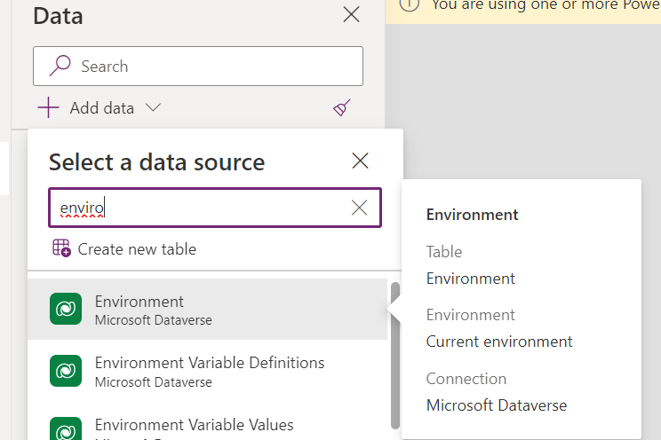
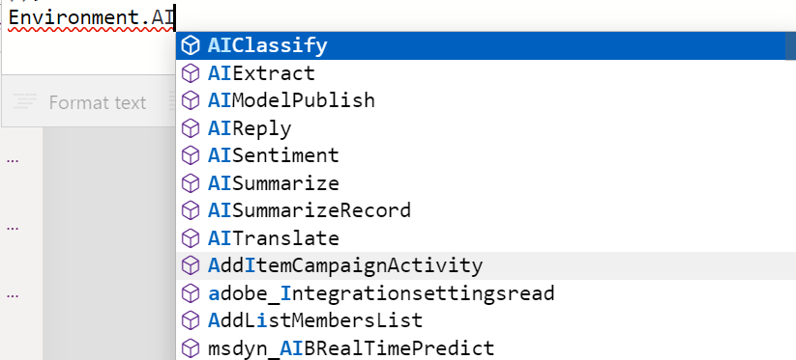
Canvas App PowerFX
Add the Power Fx Environemnt object as datasource
Supports multiple environments
Default name is Environment, you can rename it
Create PA Flow and let it handle

Slide 15

AISentiment
AISentiment(Text)
Text (string)
The text to do the sentiment analyzis on.
Returns (AnalyzedSentiment)
Sentiment values are Positive, Negative, Neutral
Findings
Seems accurate
Notes:
Does its job nicely.
Accurately gives back sentiments
No problem found

Slide 16

AIClassify
AIClassify(Text, Categories)
Text (string)
The text to classify based on the provided categories
Categories (string collection)
The collection of categories/tags to choose from
Returns (Classification)
Classification value can be „Unclear” or one of the provided categories
Findings
A lot of the time it is accurate
Can’t be used for more granular sentiment analysis
Sometimes returned category is prefixed with various things, like „Category:”. Needs extra validation.
Sometimes it gives back really strange results.

Slide 17

AIExtract
AIExtract(Text, Entity)
Text (string)
The text to extract entities from
Entity (string)
Type of entities to extract from the text
Returns (ExtractedData)
Collection of the extracted entities. Can contain zero or more items.
Findings
Still in development
Looks like it doesn’t work at all. Always gives back empty collection.

Slide 18
AIReply
AIReply(Text)
Text (string)
The text to respond to. Can be an email, a review comment, etc...
Returns (PreparedResponse)
Gives back a suggested reply text.
Findings
Sometimes it repeats back some talking points, without a real suggested answer.
If text is too long, it echos back original text.

Slide 19
AISummarize
AISummarize(Text)
Text (string)
The text to summarize.
Returns (SummarizedText)
Summarized text.
Findings
Summarization seems accurate.
Can reduce text size considerably

Slide 20
AISummarizeRecord
AISummarizeRecord(EntityLogicalName, Id, IsMergedCatchupAndSummary)
EntityLogicalName (string)
Logical name of the provided entity record
Id (string)
GUID string of the record in question
IsMergedCatchupAndSummary (bool)
Include in the summary what has changed on the record
Only works for lead and opportunity entities right now
Returns (SummarizedText)
Summaraized key information about the passed record

Slide 21
AISummarizeRecord
Findings
As per documentation IsMergedCatchupAndSummary flag only works for lead and opportuntiy entities at this time
It seems like it only works at all for lead and opportunity entites.
So, no other base- or custom entities are supported yet
Returning format uses bullet points with dash(-) character

Slide 22
AITranslate
AITranslate(Text, TargetLanguage)
Text (string)
Text to translate
TargetLanguage (string)
Code of the target language
Returns (TranslatedText )
Translated text to target language
Findings
Valid language codes are the IETF BCP 47 language tags
Seems like it doesnt work properly in PowerFX
Regardless of defined TargetLanguage, it returns English translation/text

Slide 23
Other Ways to use them
Via
AI Builder connector
OrganizationRequest in plugin steps and Custom API
Client-side SDK from webresources, PCF controls
WebAPI calls from external sources

Slide 24
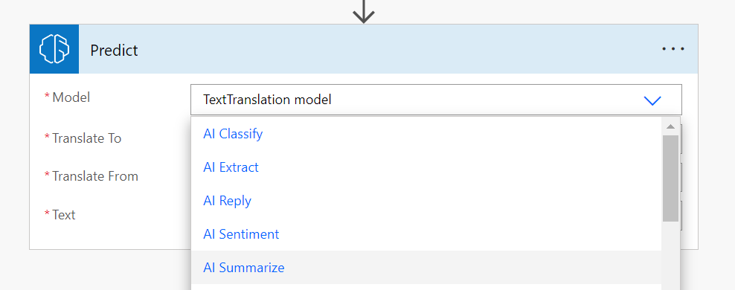
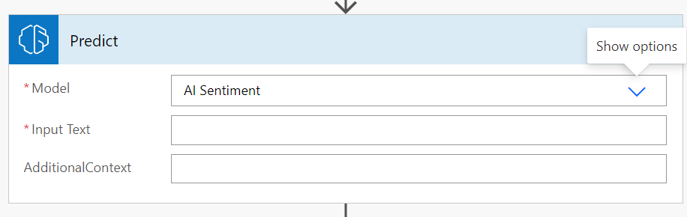
Power Automate AI Builder
You can use the exact same models from the AI Builder Connector, but with additional context

Slide 25
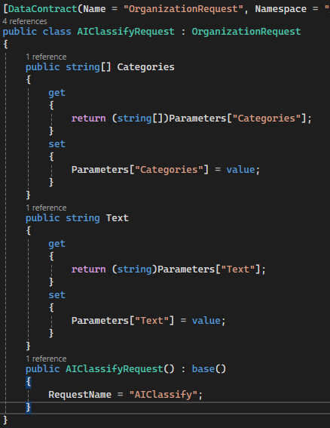
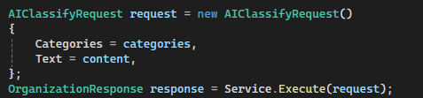
Server Side Plugins, Custom API
Easy to use
Parameterize on the fly, or extend the OrganizationRequest base class
Execute with the Org Service

Slide 26
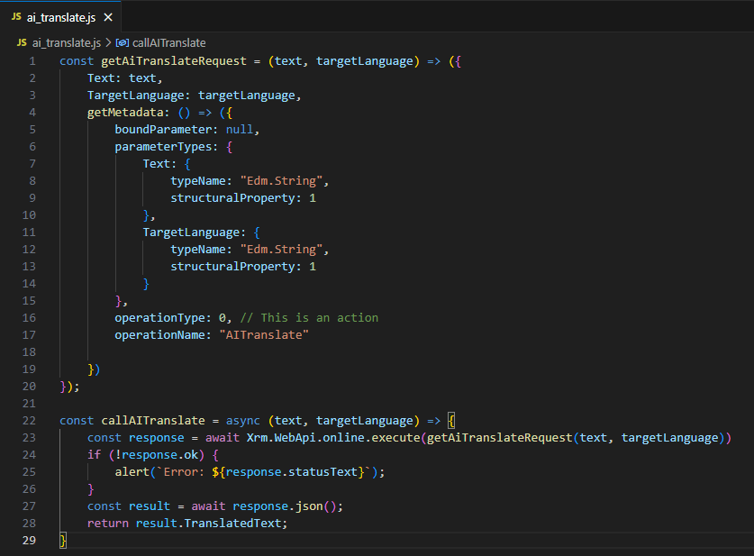
Client Side JavaScript
Easy to use
Create request object
Execute with the Xrm.WebApi.online

Slide 27
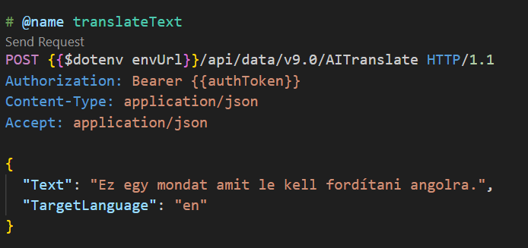
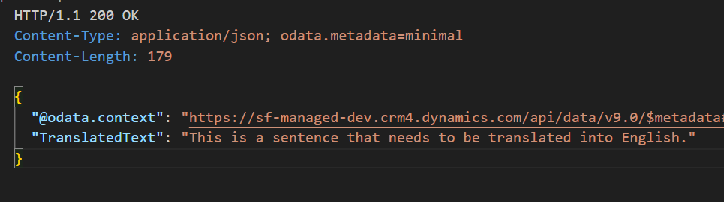
At its core
Its just a HTTP call against the Dataverse Web API
POST with the parameters payload

Slide 28
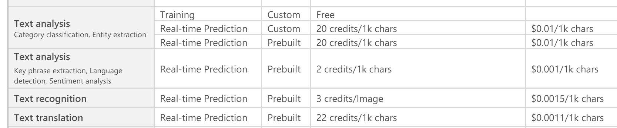
Licencing
The used undelying models live under AI Builder
AI Builder credits aquired trough Entitlements or Add-on packs
Cost determined by processed data amount

Slide 29
Summary
Pro
Pre-trained and configured models
Can be used instantly
Part of the Dataverse Web API
Can be implemented in a wide varienty of ways
Contra
No customization, no additional context
Still in development
AISentiment
AISummarize
AIExtract
AISummarizeRecord
AIClassify
AITranslate
AIReply

Slide 30
Sources
Trial and error
Power FX documentation: https://learn.microsoft.com/en-us/power-platform/power-fx/reference/function-ai
Dataverse Actions reference: https://learn.microsoft.com/en-us/power-apps/developer/data-platform/webapi/reference/actions?view=dataverse-latest
Javascript action call: https://learn.microsoft.com/en-us/power-apps/developer/model-driven-apps/clientapi/reference/xrm-webapi/online/execute
Get started with plugins: https://learn.microsoft.com/en-us/power-apps/developer/data-platform/tutorial-write-plug-in
Power Apps Licensing: https://go.microsoft.com/fwlink/?linkid=2085130
AI Builder credit management: https://learn.microsoft.com/en-us/ai-builder/credit-management
Language tags: https://en.wikipedia.org/wiki/IETF_language_tag

Slide 31
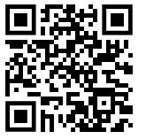
Git repo https://github.com/csonthejjas/DataverseAIActions

